Slide 1
PART 6: Xamarin UI Tests
OPERATION: REMOTE RESUPPLY

Slide 2
Xamarin UI Tests
Starts with Xamarin.UITest
Based on Calabash
Execute tests in C# and NUnit
Integrates with Xamarin.Android and Xamarin.iOS
Can be used with native platforms
Calabash Tests
App
Calabash Client
Agent
Notes:
The foundation for testing Xamarin mobile apps begins with Xamarin.UITest. Xamarin.UITest is a testing framework, based on Calabash, that allows programmers to write and execute tests in C# and NUnit that validate the functionality of iOS and Android apps.
Xamarin.UITest integrates with Xamarin.iOS and Xamarin.Android projects but it can also be used with iOS and Android projects written natively in Objective-C/Swift and Java.

Slide 3
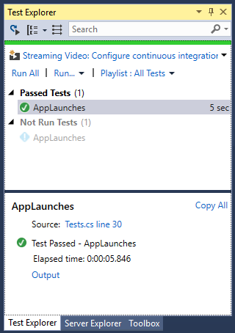
Integrating Xamarin.UITest
Add a UI Test App project to your solution
Ensure NuGet packages are up-to-date
Specify the location of the target app
Write or record tests
Run tests
View results in the Test Explorer
Notes:
Integrating Xamarin.UITest into a Xamarin solution is as simple as adding a new UI Test App project and selecting the Xamarin.UITest (Cross-Platform) template in Visual Studio.
Depending on the build of Visual Studio 2017, you may need to update both the Xamarin.UITest and the NUnitTestAdapter NuGet packages. NOTE: DO NOT UPDATE the Nunit package, as Xamarin.UITest does not support versions higher than 2.6.x.
Targeting locations for apps to be tested is accomplished by setting platform-specific installed app or installed path locations. The Drone Lander solution uses the installed app method and requires a developer to specific the package name when configuring the test runner.
Tests and Test Runs are managed via the Visual Studio 2017 Test Explorer.

Slide 4
Writing Test Scripts
[Test]
public void AppLaunches()
{
app.Flash(x => x.Text("Sign In"));
app.SetOrientationLandscape();
app.PressVolumeDown();
app.PressVolumeDown();
app.SetOrientationPortrait();
app.Flash(x => x.Button("Reset"));
app.PressVolumeUp();
app.PressVolumeUp();
}
Marked with the NUnit Test attribute
Written in C#
Typically work against the platform-specific app object
Can leverage standard .NET Framework libraries
Can interact with the device
Notes:
Xamarin.UITest test scripts are written in C# and can take advantage of the same level of .NET Framework support available in Xamarin Forms.
To facilitate specific actions in test scripts, Xamarin.UITest provides a comprehensive testing API that includes support for taking screenshots, identifying page and control elements, performing actions such as button taps and text entry, as well as a large number of options for querying control state and even waiting for control state changes and interacting with the device.
This example, which comes from Part #6, demonstrates a test script that identifies controls, changes device orientation, and accesses device volume controls.

Slide 5
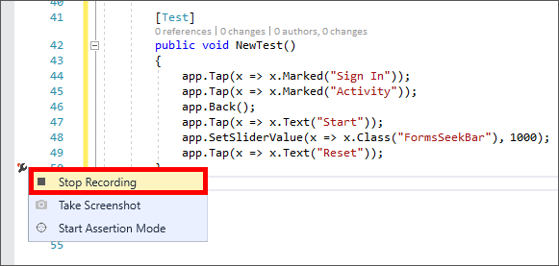
Xamarin Test Recorder
Helpful when new to Xamarin.UITest or unfamiliar with APIs
Connect to real devices, or simulators/emulators
Generates C# test script code
Notes:
The Xamarin Test Recorder can simplify creating tests and is a good place to start for if you are new to Xamarin.UITest or unfamiliar with the APIs.
The Xamarin Test Recorder is a stand alone Visual Studio 2017 extension (installed via Visual Studio 2017 Extensions and Updates) that can "record" how a user interacts with an application, and create automated tests in C# based on those interactions.
Testers can start Test Recorder, connect it to device, simulator, or emulator, and then start using the mobile app. Test Recorder will capture the interactions between the user and the mobile app, and output a Xamarin.UITest in C# for that scenario.
This example, taken from Part #6, shows the output of a simple Xamarin Test interacting with the Drone Lander app.

Slide 6
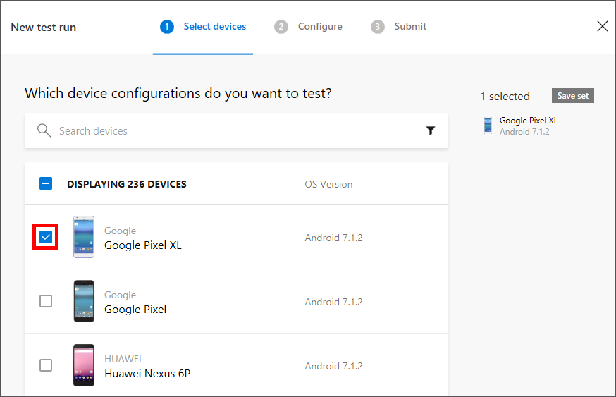
Integrating Mobile Center Test
Create tests in a Xamarin.UITest project
Create a Test Series
Create a Test Run
Upload tests to Mobile Center using the Mobile Center CLI
Integrate into the Build, Test, Distribute lifecycle
mobile-center test run uitest --app
Notes:
Once tests have been created in a Xamarin.UITest project (by using Test Recorder, writing code, or both) the tests can be uploaded to the Visual Studio Mobile Center and integrated into the Build, Test, and Distribute lifecycle.
Integration and configuration of Mobile Center Test is accomplished via the Mobile Center portal, however the actual “upload” of tests currently requires the use of the Mobile Center command-line interface (CLI)

Slide 7
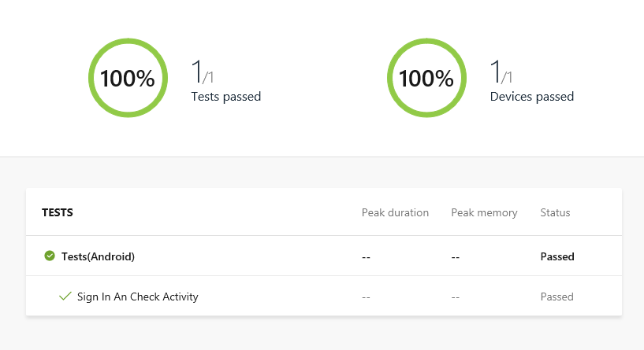
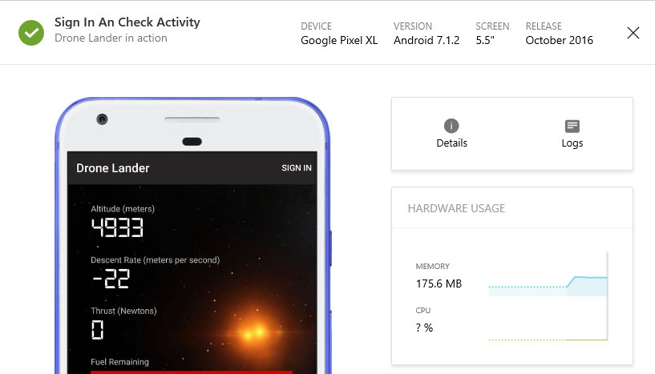
Viewing Mobile Center Tests
View test results based on pass/fail
View case and device-specific test
Run tests against hundreds of device configurations
View logs and stack traces
Notes:
Viewing tests in the Mobile Center is accomplished via Test Reports. Test Reports are the final output of a Test Run.
A Test Report includes overall pass/fail status, a detailed breakdown of pass/fail status by manufacturer, operating system version, and form factor, and assets such as screenshots and device logs. Test reports are viewable in the Mobile Center portal.

Slide 8
Lab Walkthrough
Xamarin UI Tests

